Slide 1
Spotswood and South Kingsville
Better West Inc - Better Places

Slide 2
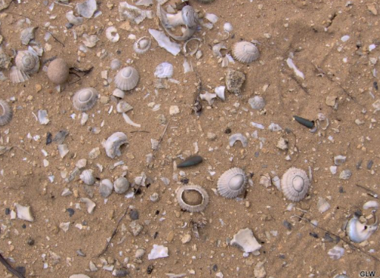
Acknowledgement of Traditional Owners
There is tens of thousands of years of history in what is now know as Spotswood and South Kingsville. Subject to the consent of Boon Wurrung traditional owners, this could be done through signage and story telling in our parks and public spaces.

Slide 3
Better West Inc
Better West Inc₁ is an incorporated association formed in 2016 in response to the consultation on concept designs for what became the West Gate Tunnel Project. The issues that concerned residents in Spotswood and South Kingsville then remain constant:
Impact on local traffic leading to greater truck numbers and congestion
Deteriorating air quality
Lack of open space for current and projected population.₂
Notes:
Better West Inc Betterwest.org and facebook group
Hobsons Bay Open Space Strategy, 2018 p139 - 142

Slide 4
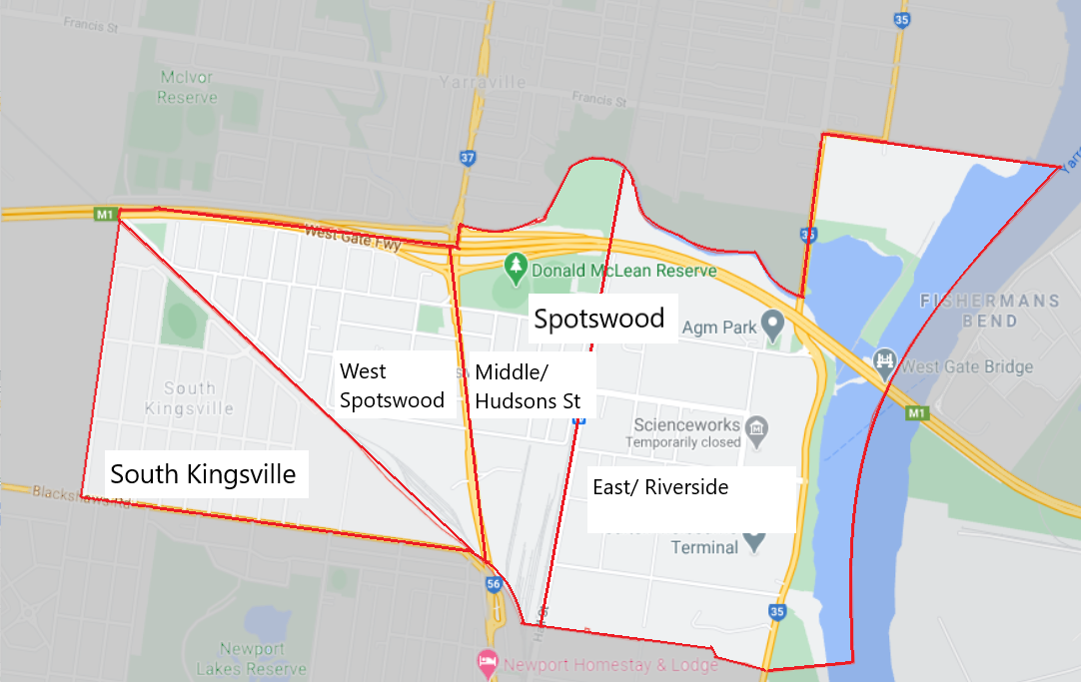
Spotswood Dreaming…
Better West set about a project to tap into the views of our members and residents. We:
Collected residents views at Slow Food Melbourne Farmers Markets at RSL over many months in 2019
convened meetings with ward councillors and officers (2018 and 2019)
Collected views from Facebook
Conducted a petition presented to Council in September 2020
Conducted a workshop with members to address Better Places and LAMP maps and issues papers (December 2020)

Slide 5
… Look and Feel.
Spotswood and South Kingsville:
Optimistic
A good place to live
The gateway to Hobsons Bay from the iconic West Gate Bridge
A rich indigenous and post colonial industrial past
Close to major activities but still with its own sense of place
Distinctive and separate neighbourhoods
There is a sense that the time has come to restore both the natural environment and our residential communities with values that promote human scale living alongside industry transitioning away from fossil fuels and embracing businesses based on new and emerging technologies

Slide 6
South Kingsville
Restore Paisley Station₃ to create addition PT options
Restrict car movements from Precinct 15 into South Kingsville and route car traffic to Blackshaws road
Advocate for a direct, and high frequency bus route with prioritised access to Spotswood/ Newport stations for the new Precinct 15 bus and for other buses in the area to encourage sustainable transport use for Precinct 15_{4,5}
Install multiple pedestrian crossings on Blackshaws Rd – Newport Lakes, Sutton St and New St.₆
Design a safe and direct bike route from Precinct 15 to Spotswood station
Add more bike racks/parking along Vernon St.
Better West supports one way treatment of Vernon St and the traffic treatments outlined in the Precinct 15 Developer Contribution Plan (DCP)
Community garden in parklet on Vernon and Aloha Sts
Notes:
Restore Paisley Station We note that the area has plentiful off street car parking. This train station, identified as a need by the (Hobsons Bay) council in their Integrated Transport Strategy, will provide benefits to the people in Altona North and Newport area including: (a) greatly improving transport options for people in Altona North and; (b) activating and revitalising the southern Altona North area;(c) providing public transport access to the Paisley Park sports and recreation precinct and local schools, and;(d) alleviating some pressure from Newport station.
Presentation to Council and Melissa Horne 2020 by T4e, VTAG and Peter Parker. PPT available. Reference to Precinct 15 recommendations
HBCC to revise policy on dispersal of traffic from major developments into local streets. This creates local congestion. Precincts 15, 16 and 17 all have direct access to major roads – Melbourne Rd and Blackshaws Rd to which residents want direct access. Dispersal into local roads such as New St , Birmingham and Cullen St increases congestion on local roads – Hudsons Rd and The Avenue to access Melbourne Rd.
Traffic calming theory suggests that pedestrian crossings at regular interval slow traffic

Slide 7
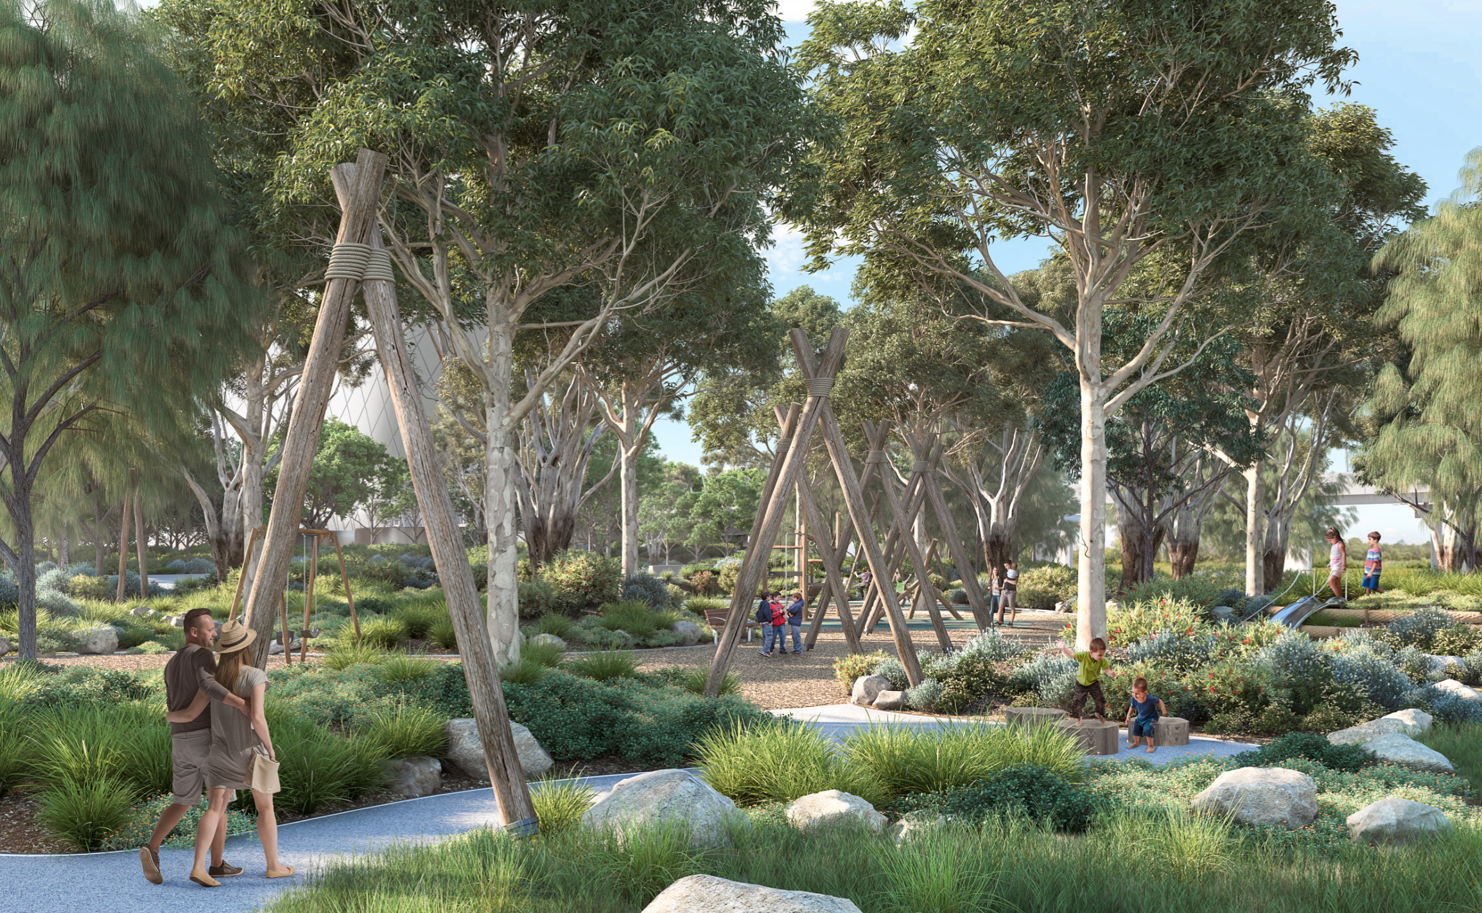
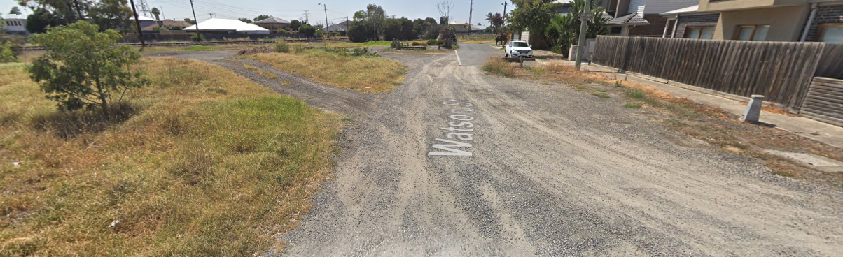
South Kingsville
Expand on the Watson St park (being developed by WGTP) ₇ by:
      extending the park into the Watsons St road reserve
      discontinuing Watson St road and its connection into Precinct 15
      connect the Watsons St park to Edwards Reserve
      extend the planned bike path along the back of Edwards Reserve to Birmingham St
Watson St Park (artists impression)
CCTV surveillance in the Watson St area
Upgrade the area of the bike and pedestrian path linking Spotswood & Sth Kingsville with sensitive conservation area plantings (native frogs inhabit this area)
Watson St (currently)
Notes:
Watson St park details https://westgatetunnelproject.vic.gov.au/__data/assets/pdf_file/0007/387655/190724_WGTP2022_WGTP_Southern-Portal_Summary-WEB

Slide 8
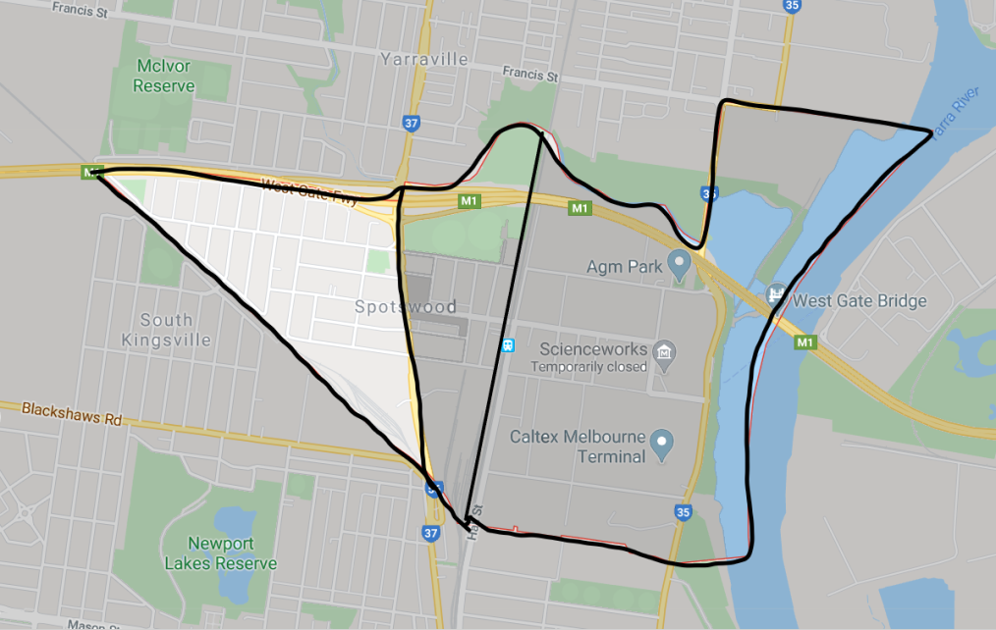
West Spotswood
Upgrade existing informal pedestrian path west of Newport-Spotswood bridge to connect to Newport Station servicing Precinct 16 and 17 ₈
Mary Street Reserve _{9,}
Review the lease for clubs
redesign open space for play, food production/ preparation and grassroots community uses/users
Create a Spotswood Community Hub (see slide 21)
The Avenue
Pedestrian crossings and traffic calming along the the length of The Avenue
Prevent U-turns at Melbourne Rd intersection
Separated bike path
Notes:
Residents reported safety issues preventing people using Newport bridge acting as a barrier connecting to Newport and Newport Station that will be exacerbated with population growth from Precincts 16 and 17
Mary St Reserve currently holds a small playground with equipment favouring young children, a part netball/basket ball court with asphalt and small gardens with no seating or water. The rest of the reserve is made up of cenotaph, RSL with disused bowling green and another Cenotaph. The RSL offers few services to community except on a venue hire basis and as the location of a monthly farmers market and weekly scaleable model builders club and a dog day. There is is no veteran’s welfare programs. HBCC funded sustainability, food and well being programs have not eventuated nor adapted to the online delivery. Mary St reserve is in proximity to new developments for which additional open space will be valuable.

Slide 9
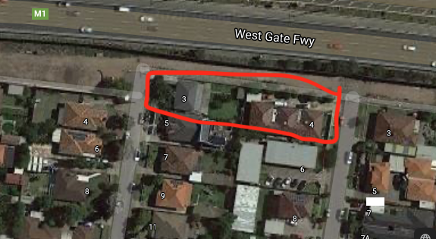
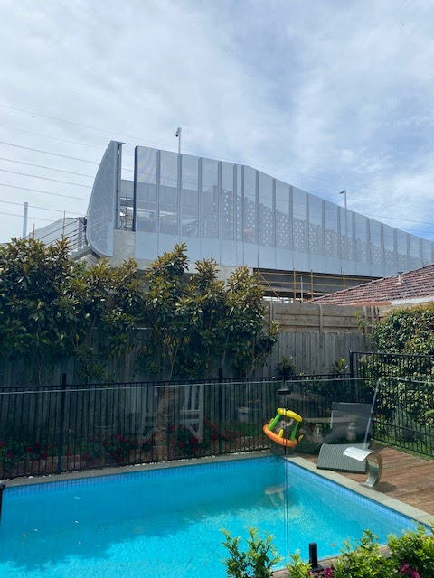
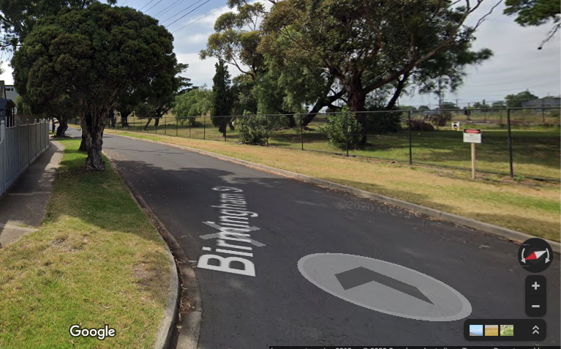
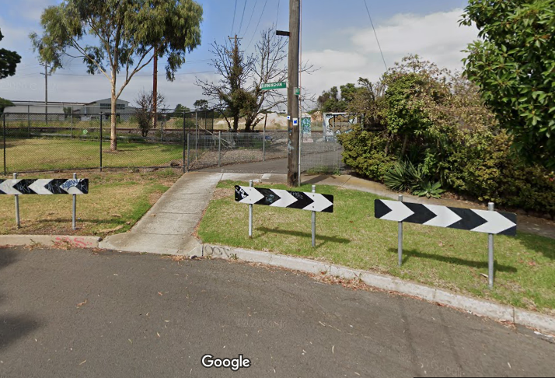
Ferguson street ₁₀
Build a pocket park and property compensation immediately adjacent to new pedestrian bridge.
Mitigating loss of canopy, poor air quality and privacy
Create safe path for children
Birmingham St ₁₁
Protect this street as a vital bike connection for new residents of Precinct 15 and 16 to Spotswood
Don’t allow parking on, or car access to Birmingham St, from Precinct 17₁₂
Enhance South Kingsville / Spotswood bike connection across the rail
Notes:
Design for pedestrian crossing has been significantly changed from EES.. The properties pictured are overshadowed by the structure akin to a multi storey building on boundary. There is insufficient space for children to safely access the pedestrian bridge. There has been huge loss of canopy to widen freeway and an additional 30,000 vehicles a day. Increase of air and noise pollution not entirely addressed by barriers.. Representation has been made to Melissa Horne, Jacinta Allan and to HBCC to support the voluntary acquisition of these properties by the state and to create a pocket park which will have a number of social and health benefits. It creates a landscaped area: safe access to stairs and from ramps; a play space in an area with lots of children; increases % of open space in, planting for WGTP tree program close to affected residents; mitigates poor air and noise quality; and screening to protect privacy of residents from pedestrian crossing and its 360 CCTV.
Residents oppose the traffic planning for Melbourne Rd Development Application (Planning permit application PA1945411.
Support the Precinct 15 plan for Birmingham St to be a cycle and pedestrian link connecting to school and activity centre. Dispersal of underground car park to Birmingham and Cullen St will create a rat run to Hudsons Rd and The Avenue rather than providing direct access to Melbourne Rd from the UGL intersection. Birmingham St is not wide enough to accommodate street parking, two way traffic and a Share User Path. This will become a high volume pedestrian and cycling pathway and the interests of active transport should be prioritized over personal car use of residents in an area with good levels of public transport – bus and train.

Slide 10
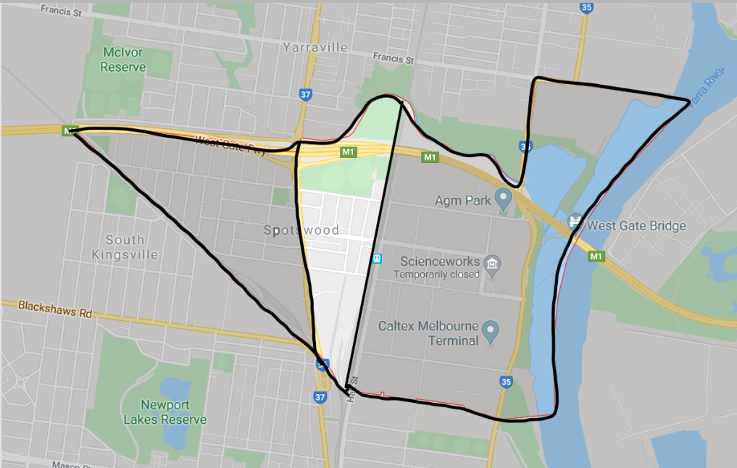
Middle Spotswood
Melbourne Rd
Spotswood as entrance to Hobsons Bay and the peninsular - greening and art work
Hudsons Rd ₁₃
Traffic calming through engineered treatments. Insert separated cycle track, trees, street furniture and water, sensitive urban design features.
Pedestrian crossing at 200m intervals to slow traffic,
Street trees,
Separated bike path and lower speed limit to calm traffic and inhibit heavy vehicles.
Residential streets
Consider alternate one way streets with chicanes supported by green infrastructure
Spotswood Station (Platform 1) Hope St
Place making and urban greening around Spotswood station / shops. Closing streets Hope or Robert with plaza supporting seating, storage, shade and water bubblers. A gathering place. Improve underpass – lights, CCTV and art work.
Notes:
Consider a range of traffic calming measures for shopping strip and residential areas, some examples of differential treatments Changing Contexts

Slide 11
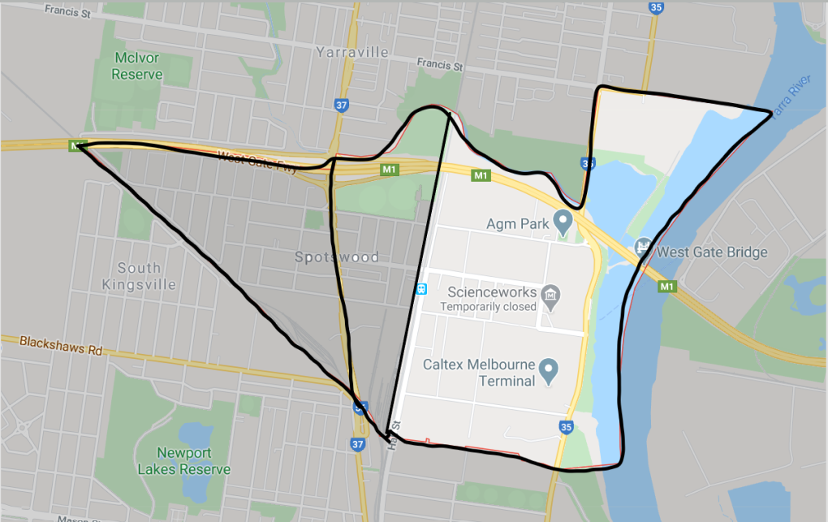
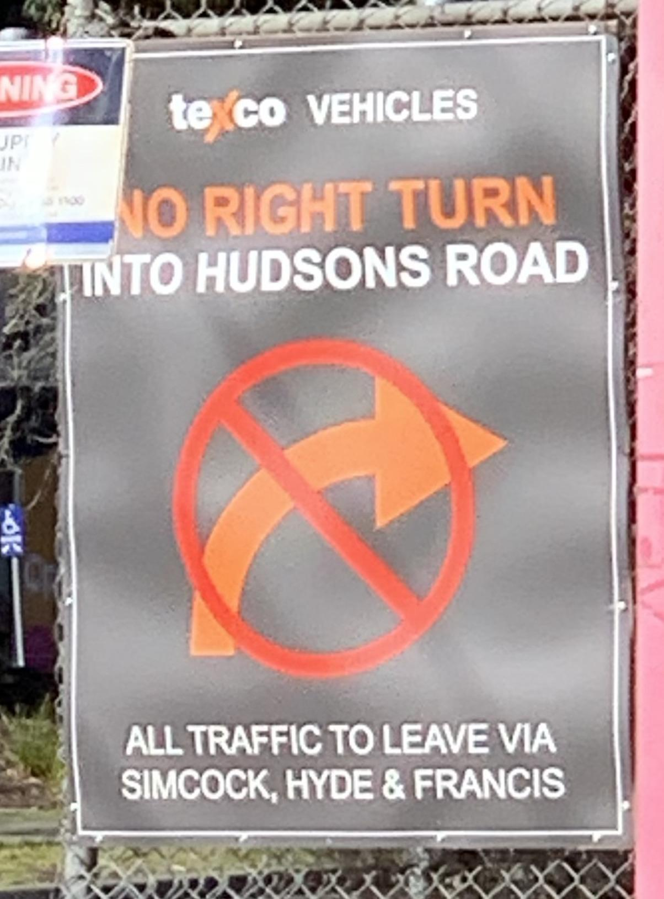
East Spotswood
Planning scheme amendments suggested for land on Hudsons Rd (south east) to mitigate the establishment of new heavy industry / heavy vehicles with exemptions via Hudsons Rd to Melbourne Rd and freeway._{14,15}
Full implementation of proposed landscape rehabilitation along southern bank of Stony Creek backwash and explore potential for expansion and linkage with surrounding land parcels.
Better lighting, connectivity and wayfinding to Scienceworks, Grazelands and the Westgate Punt
Pedestrian and cycle crossing of Douglas Parade linking Scienceworks to river (cycle paths and punt)
Development of the Glassworks Social Club for community or arts space and continuing support for Sleep Bus initiative.
Notes:
Council to not renew temporary development permit for Simcock Ave gateway to Visy Glassworks forcing Linfox trucks to enter site via Hall St and Simcock Ave from the west. Query existing use permits for Symal and future uses for Cadence developments to exclude heavy vehicles from Hudsons Rd.Simcock Ave west of start of H2 ramp be reserved for commuter parking and limit car parking on Hall St. Truck bans coming into force with WGTP completion incentivises businesses in Spotswood to take advantage of truck ban exemptions. See O’Brien recommendation for using exemptions to Francis St (arterial road) rather than Hudsons Rd (Local Road) IAC evidence. Only land use changes (long term) or road closures will change behaviours,
2001 Spotswood Structure plan recommended land use change. 20 years on nothing has changed!

Slide 12
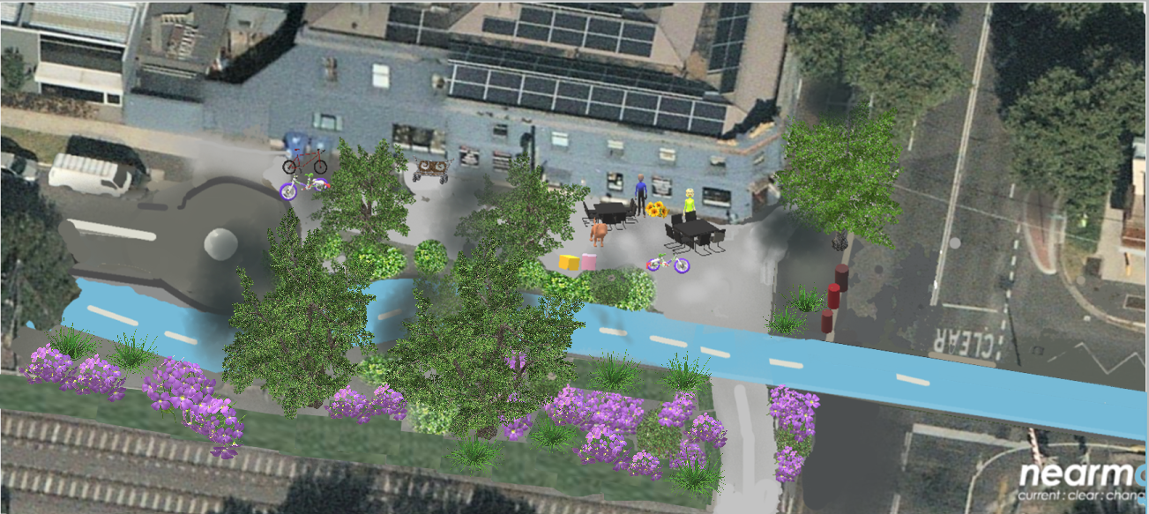
Build a Better Hall St
This proposal
Stops trucks from using Hall Street (n);
Creates a safe pedestrian plaza at Hudsons Road;
Closes Hall Street north of Simcock Avenue to create a community park (as per the Hobsons Bay Open Space Strategy);
Adopts a 'trees lead' approach to city planning, design and delivery (as per the Hobsons Bay Urban Forest Strategy).₁₆
Notes:
HBCC Open Space Strategy- “Investigate opportunities for land acquisition for the development of a new community park in the Simcock Avenue area
Hobsons Bay Council and LeadWest have also been made requests for the Project to convert some of the existing privately owned land along Simcock Avenue to public open space with links to the Stony Creek Reserve and to Scienceworks Museum and the Coastal Trail.
Application of HBCC Urban Forest policy

Slide 13
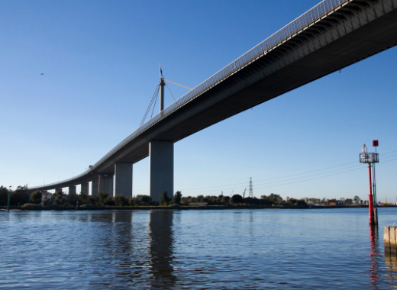
Improve connection to Spotswood’s two significant water connections, Stony Creek and the Maribyrnong River
Spotswood is currently almost completely disconnected from these two important landscape features. Yes, ports and oil infrastructure is a barrier but we must plan for a long term future when the pipe are removed and heavy industry in this area declines. The WGTP SUP will help but this should just be the beginning to a rediscovered connection to water and place for Spotswood.

Slide 14
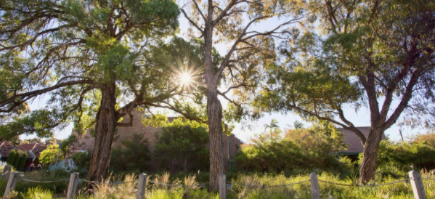
Urban Forest and Canopy cover Targets
HBCC’s Urban Forest Strategy is a good start but developments such as the one at Birmingham Street are likely to destroy significant old trees. If these are to be replaced somehow planning must start now. Trees take a long time to grow!
Work with local communities to map out how Council level urban forest targets will be met for specific neighbourhoods, what kind of planting and where.
Opportunities to identify a program of small street/neighbourhood projects over a period of time in next stage of Better Place,

Slide 15
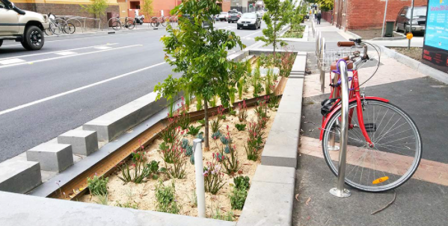
Integrated Water Management
Provide more water sensitive urban design (WSUD) and stormwater harvesting in Spotswood and Sth Kingsville. WSUD in our streetscapes can help to provide more water for greening and cooling, act as traffic calming, and reduce pollution into our waterways.
Better West support the stormwater harvesting project planned for the Donald Mclean Reserve and the use of this water to irrigate the passive open space in the reserve.

Slide 16
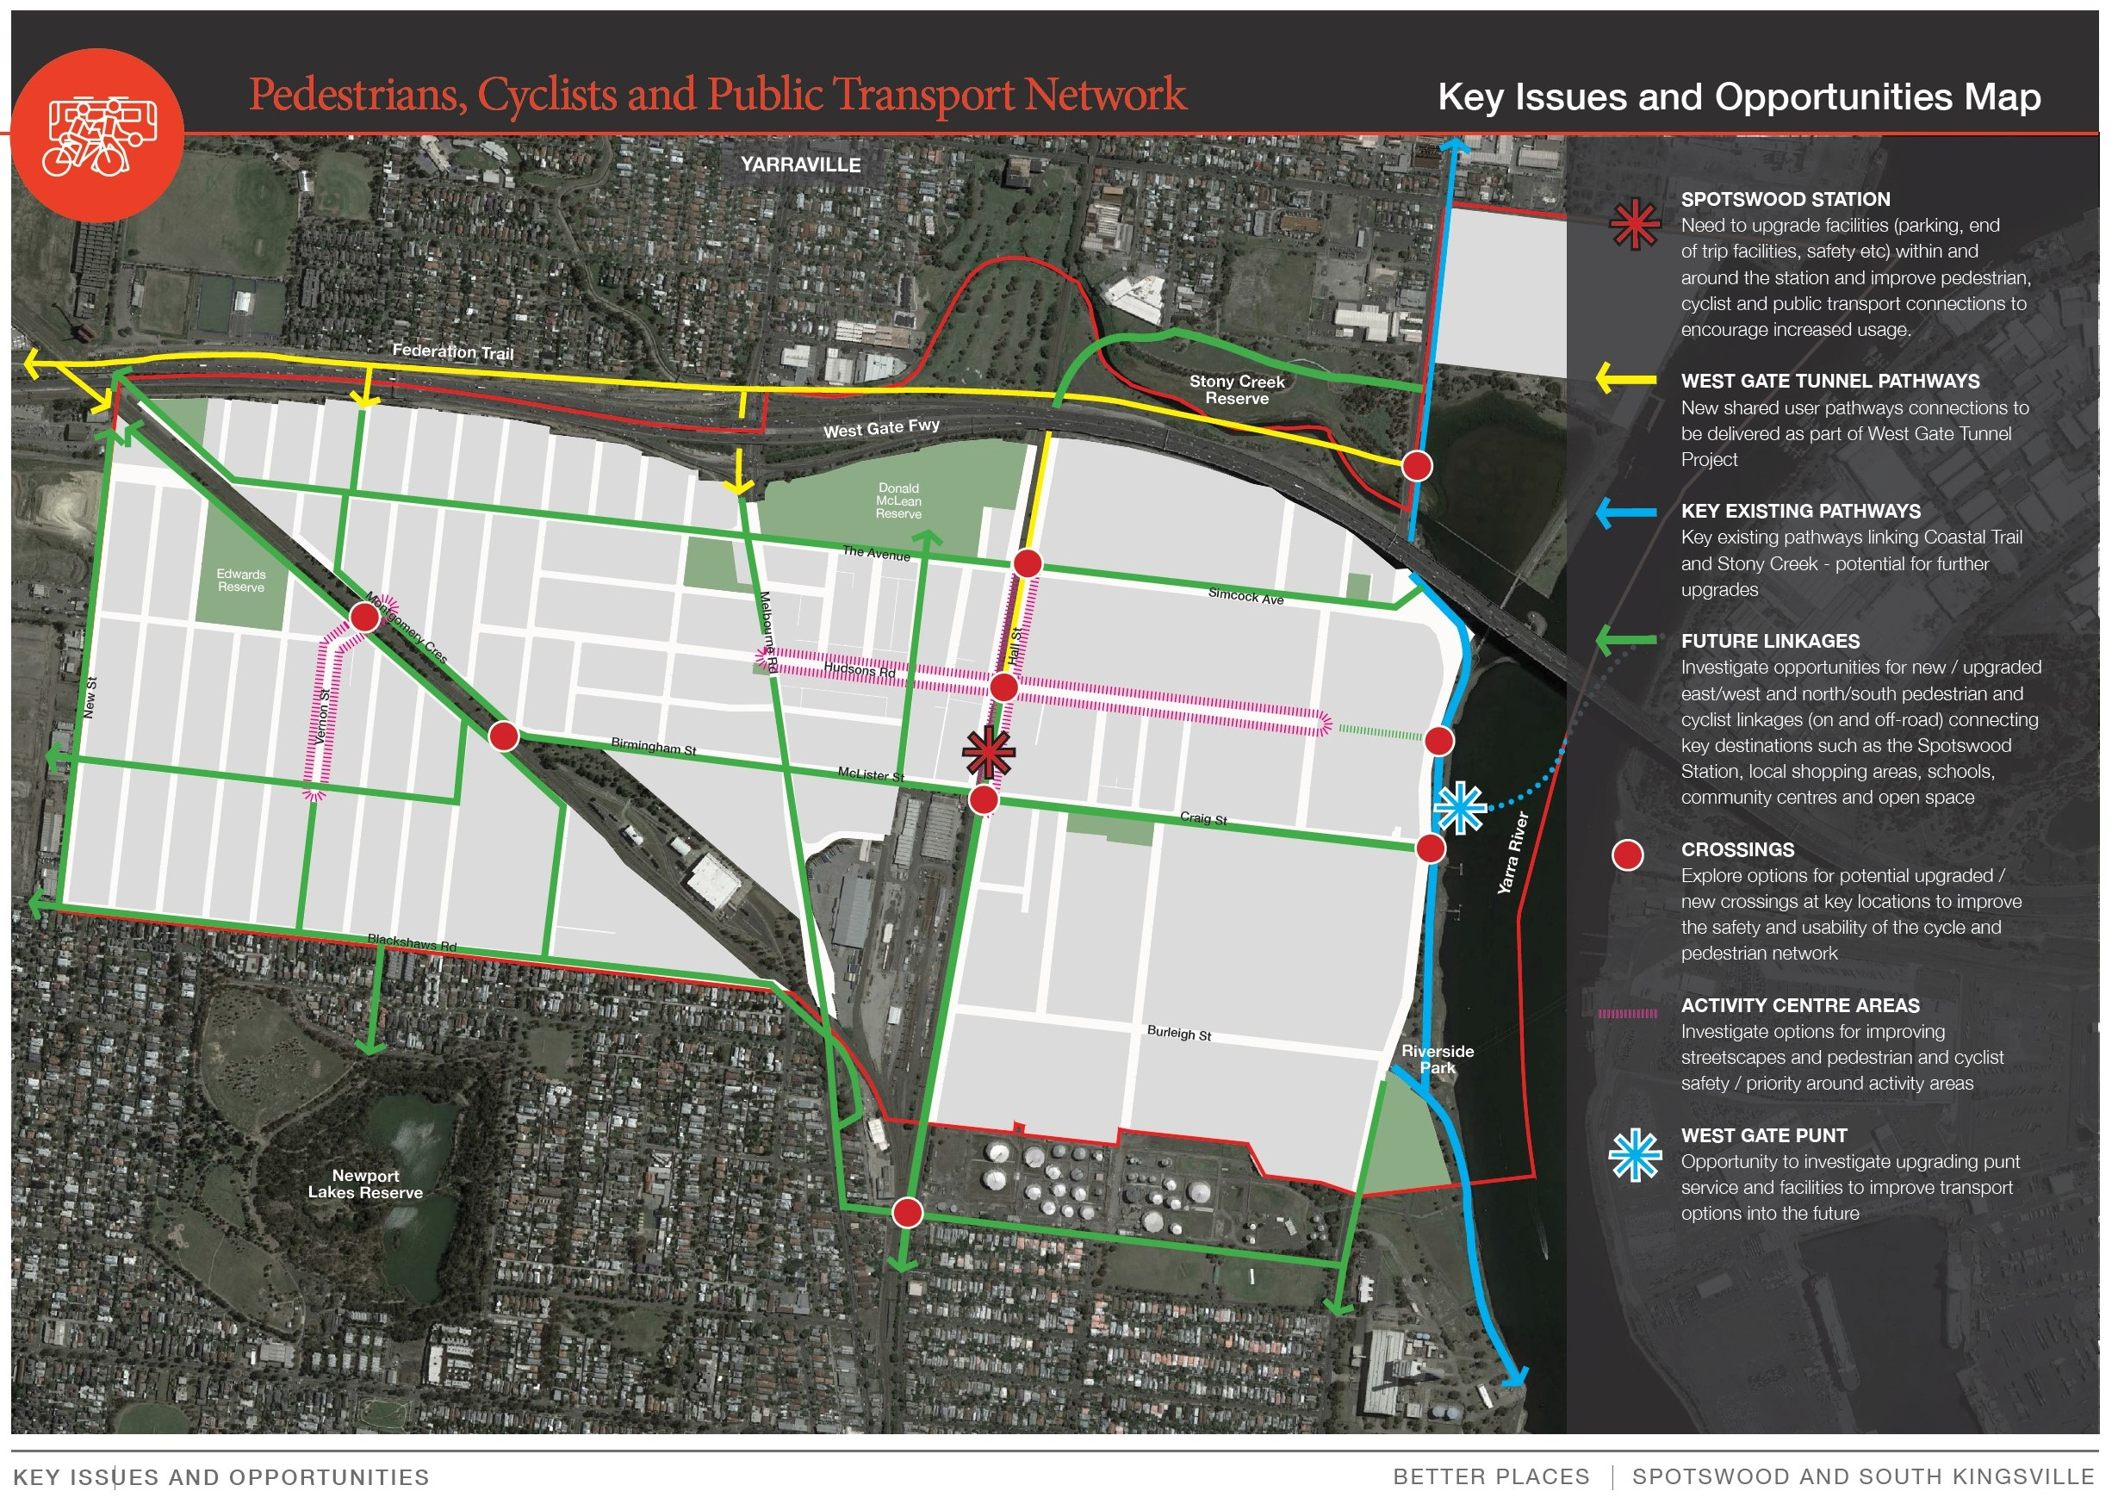
Pedestrian, Cyclist and Public Transport Network
Spotswood station
Pedestrian crossing over Hope St north and Hudsons Rd (west)
Consider a one way street with more extensive plaza, greenery, set down area
Car park on Simcock Ave with fees
Close Hall St north of Hudsons and have crossing for cycles
Keep LX – removing it would induce more traffic.
West Gate Tunnel Pathway
New St (Slide 7)
Hall St Revisit SUP and road design (See Build better Hall St Slide 12)
Key Existing pathways
There is conflict with traffic plans for Melbourne Rd development Precinct 17).₁₉ and recommendations for Precinct 15.
Pedestrian Crossings
Blackshaws Rd at Sutton St, Vernon St, New St
Concerned about crossing of SUP at Hyde St
Recommend road closure of Hall St at Simcock Ave intersection
Support way finding and pedestrian crossing of Douglas Parade to support Westgate punt
Notes:
Bicycle and pedestrian conflict on SUPs Community prefers separated bike paths on road preserving footpaths which are mostly quite narrow for pedestrians.

Slide 17
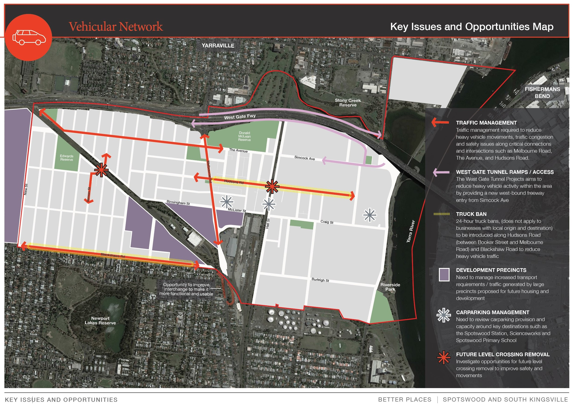
Vehicular Network
Traffic management
Truck bans are an ineffective strategy in managing heavy vehicles with most having a local destination. Volume will increase as industrial land is converted to warehousing industry. Require land use change to limit heavy traffic.
Clear routing for businesses located in industrial zoned land east of railway to use Douglas Pde for access to West via ramp and Hyde St for destination in east.
Blackshaws Rd pedestrian crossings needed to extend existing links to park lands and shops.
Signalise Kernot and The Avenue intersection
WGTP is part of the problem. It effectively moves the burden of heavy vehicles from arterial roads in Maribyrnong and increases heavy vehicle traffic on Blackshaws Rd, Melbourne Rd and Hudsons Rd to access its asset. It will draw heavy vehicles and smaller freight vehicles east bound via the WG Bridge
Level Crossing
No support for LX removal on Hudsons Rd
Support LX removal South Kingsville and reengineering roundabout Moresby St, Brunell St.

Slide 18
Vehicular Network
Car parking management
Research₁₈ shows that provision of free car parking:
induces use of cars
wastes valuable public space,
increases competition for street parking for residents, and
does not increase volume of customers for street traders.
Recommend disincentivising commuter parking:
Time limited local parking with resident passes
Incentivise bus use by reviewing routes and timetables for 10 and 20 minutes services, Flexiservice (eg Rowville)
Provide active transport infrastructure to Spotswood Station and Primary School such as ‘walking bus’ to local schools (job creation) and safe storage of bikes
Advocate and engage state government to open Paisley station.
Notes:
Car Parking induces traffic psychology of choice https://www.rapidtransition.org/stories/reducing-roads-can-cause-traffic-to-evaporate/

Slide 19
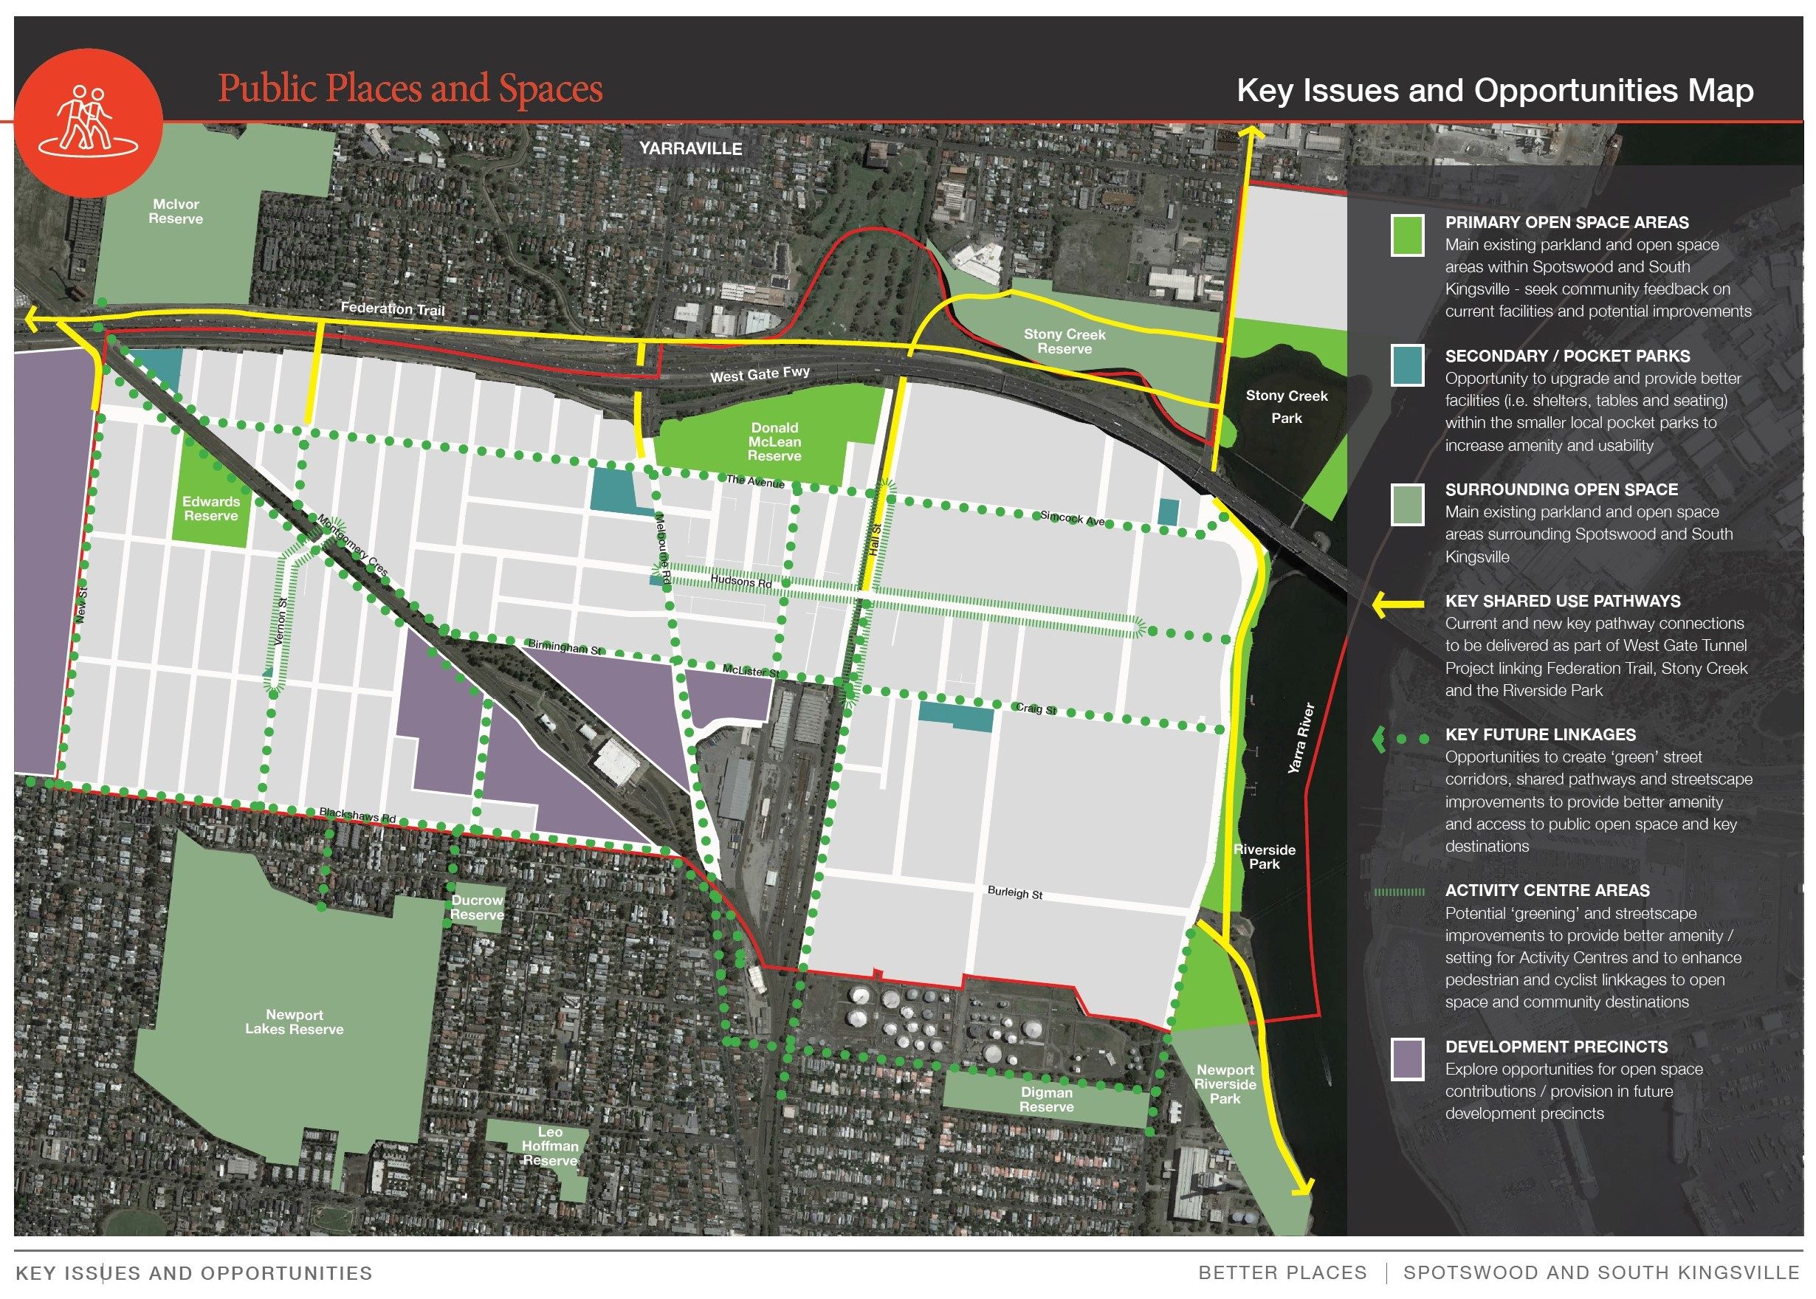
Public Places and Spaces
Primary Open Space
Design more prominent welcome to HB on Melbourne Rd
DMR -Reinstate cricket nets at the original location additional landscaping on The Avenue
Edwards Reserve – more shade and connection to New and Watson Streets.
Secondary /Pocket parks
Do not renew leases on Mary St Reserve, retain one cenotaph and redevelop as reserve as open space and community managed Hub
Advocate for voluntary acquisition of affected houses in Ferguson St Spotswood for pocket park
Moresby St greening
Share User Paths
Preference for separated paths (Use SUP as temporary measures)
Linkages
Clearer linkages to schools via WGT pedestrian bridge - St Margaret Mary School to Wembly Primary connectivity to Wembly St shopping strip

Slide 20
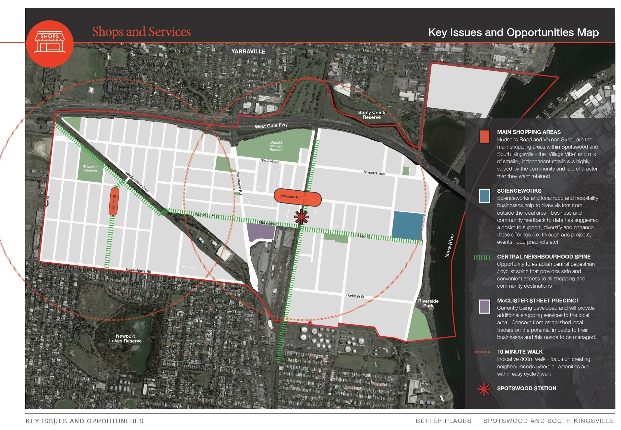
Shops and Service
Main Shopping areas
McLister retail development will expand options but needs connection to Hudsons Rd shopping precinct and traffic routing protect walking and cycling routes and access to school
The separation of Scienceworks and Grazelands by industrial zoning is problematic. Visy pocket parks and mural an improvement. ₁₉
Central Neighbourhood spine is compromised by traffic management for precinct 17. ₂₀
See slide 16 for proposal for Spotswood Station
Notes:
VCAT approved plans
Traffic studies for Melbourne Rd development

Slide 21
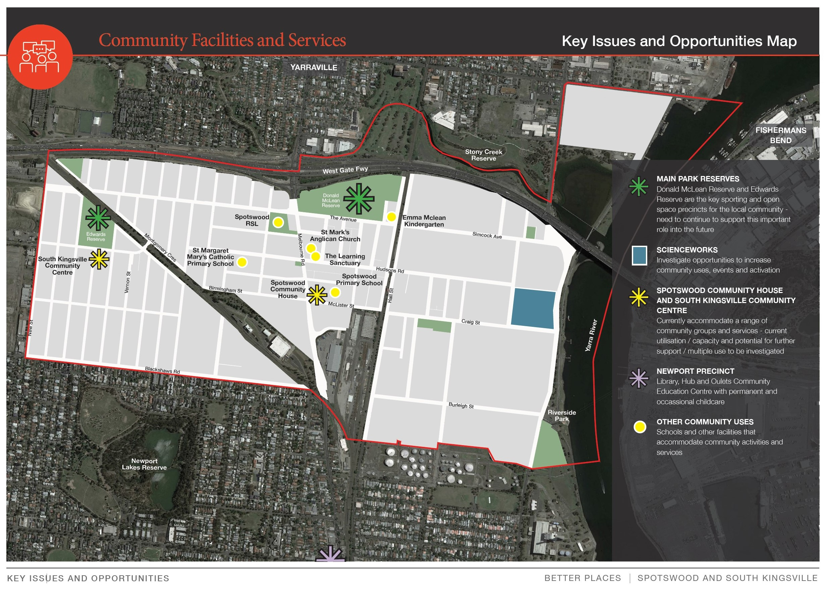
Community facilities and services
Better West Inc:
recommends Mary St Reserve be redeveloped as a Community Hub with multiple community users and uses(See Slide 22)
Supports services and activities provided by HBCC at South Kingsville Community Centre
Suggests schools open their play grounds and facilities for community use after hours.
Looks to industry to further support cultural and arts activities in Spotswood
Values the Slow Food Melbourne Farmers Market as a local service and draw card to Spotswood and seeks a secure venue to consolidate its operations in the community.

Slide 22
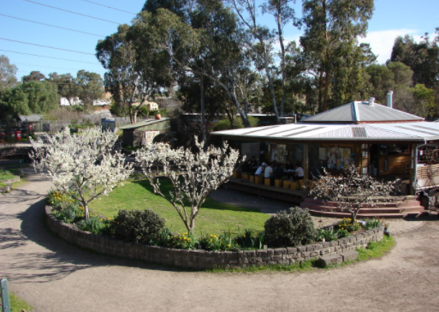
A true community hub for Spotswood and South Kingsville
The Spotswood Neighbourhood House is poorly located and ill-suited to being a true community hub.
The new Donald Mclean Pavilion will be a great place for the active sports minded contingent.
However a more general community hub is needed for those that would like to engage in other environmental type activities such as gardening and planting (for the urban forest), upcycling unwanted items, community cooking and food making, holding community events, music and cinema and just gathering as a community (e.g. Spotswood needs a mini CERES type facility)!

Slide 23
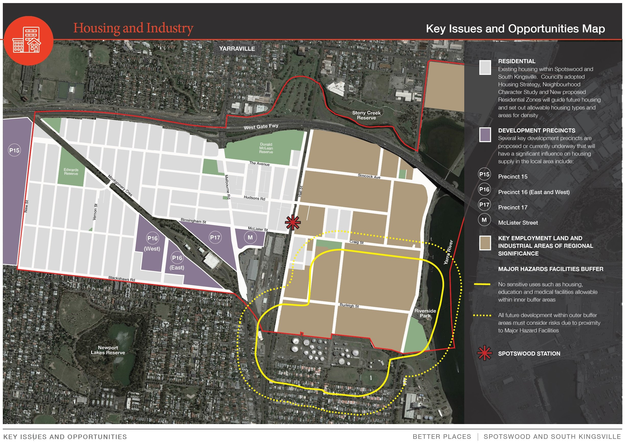
Housing and industry
Residential
Better West
supports dense inner urban development such as precincts 15, 16, 17 & McLister St but this development needs to be supported by regular, frequent and diverse public transport, active transport links and access to open space within developments or close by.
All developments should have social housing component
Industrial land
Recommend long term changes in land use to prevent heat sinks, heavy vehicle traffic and create more open space. Chemical and fuel industries are increasingly costly stranded assets
Seek industry that is less land intensive and polluting with synergies to science, technology and arts.
Value capture for land use in Spotswood – what is the best value for Spotswood in the long term?

